Slide 1
Fraud, Internal Control, and Cash
Chapter 5
ACT 205 – Fundamentals of Accounting

Slide 2
ACT 205 – Fundamentals of Accounting
Chapter 1: Introduction to Financial Statements
Chapter 2: A Look at Financial Statements & Financial Statement Analysis
Chapter 3: The Accounting Information System
Chapter 4: Accrual Accounting Concepts
Exam 1
Chapter 5: Fraud, Internal Control, and Cash
Chapter 6: Recording and Analyzing Merchandising Transactions, A/R, Inventory
Chapter 7: Long-Lived Assets
Exam 2
Chapter 10: Managerial Accounting
Chapter 11: Cost-Volume-Profit
Chapter 13: Budgeting
Chapter 16: Planning for Capital Investments
Exam 3
Chapter 8: Liabilities and Equity
Final Exam

Slide 3
Part 1: Financial Accounting
Income Statement
Revenues
Less Expenses
= Net Income
Other Comprehensive Income
Statement of
Changes in Shareholders’
Equity
Common Stock
Retained
Earnings
Statement of
Cash Flows
Operating
Investing
Financing
Balance Sheet
Assets = Liabilities + Shareholders’ Equity
Cash Chp. 5
Accounts Receivable Chp. 6
Inventory Chp. 6
Long Lived Assets Chp. 7
Liabilities Chp. 8
Equity Chp. 8
The Accounting Process – Chapters 1,2,3,4

Slide 4
Part 2: Managerial Accounting
Terms
Chapter 10
Cost-Volume-Profit Analysis
Chapter 11
Budgetary planning
Chapter 13
Net Present Value
Annual Rate of Return
Chapter 16
Tools to assist management in decision making and evaluating those decisions

Slide 5
Optional BONUS
Three potential Bonus assignments:
Book: Make it Stick, by Brown, Roediger III, McDaniels
Each essay is to be one page single-spaced typed and is worth max. 3 bonus pts each Each essay needs to answer two questions:
What do you think are the “Big Ideas” from the assigned reading?
How might you implement some of the ideas?
No late assignments will be accepted. You may turn in essays early. Print off and bring to class.
Essay #1 chapters 1-3 Due Tuesday 2/12
Essay #2 chapters 4-6 Due Tuesday 3/12
Essay #3 chapters 7-8 Due Tuesday 4/9

Slide 6
Learning Objectives
To define fraud and the principles of internal control
To apply internal control procedures to cash
To prepare a bank reconciliation

Slide 7
What is Fraud?
Fraud occurs when a person purposefully engages
in behavior that harms another person.
Fraud is the deliberate misrepresentation to gain an advantage over another person.

Slide 8
The Fraud Triangle
Opportunity
The KEY to protecting yourself and your company:
personal integrity
Pressure
Rationalization

Slide 9
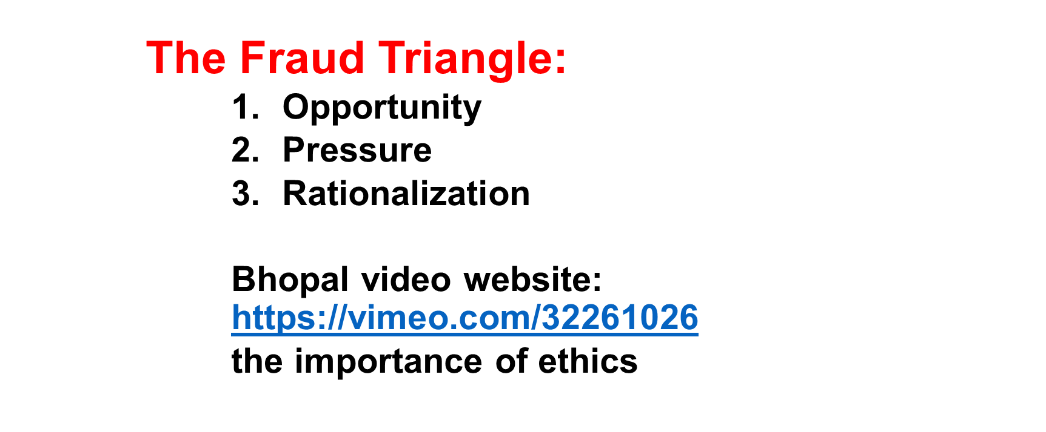
Yielding to Unethical Behavior

Slide 10

Yielding to Unethical Behavior
Common threats to NOT voicing your values
Rationalizations:
“Everyone is doing it!”
“It isn’t material so it doesn’t matter”
“It’s not MY responsibility”
“I’m just following orders”
Develop YOUR Muscle memory
Act your way into thinking
Not “what is the right thing to do?”, but “how can I act on my values”

Slide 11
What are Internal Controls?
All methods used to:
Safeguard assets
Enhance reliability of accounting records
Increase efficiency of operations
Ensure compliance with laws and regulations
(REDUCES FRAUD OPPORTUNITY)

Slide 12
An Internal Control System
Control Environment – integrity and ethical values of a company
Risk Assessment –identification of potential risks
Control Activities – internal controls
Information & Communication – internal & external reporting process
Monitoring – correction/update of internal controls

Slide 13
Six Principles of Internal Controls – key slide
Establishment of Responsibility – only 1 cashier has authority to sell movie tickets, only certain employees can make large purchases
Separation of Duties – those who record transactions separate from handling cash, treasure should sign and issue large checks
Documentation Procedures – pre-numbered tickets and checks, bills paid are to be stamped “PAID”
Physical Control – assets should be stored in a safe
Independent Internal Verification – daily/monthly/annual reviews
Human Resource Controls – bonded employees, rotate duties, background checks

Slide 14
Limitations
Internal controls can be circumvented by _____________ among employees. _____ system can prevent all fraud. Good internal controls ___________ fraud and increase likelihood of detection.
  Collusion- is when two or more people acting together circumvent internal controls

Slide 15
Controlling Cash
Preventive controls
Detective controls
  Separation of duties –
  Physical controls: Safes, Prenumbered docs.
  Proper authorization - signature cards
  Quality employees -
  Required Absences
  Procedures Manual
  Bank Reconciliations

Slide 16
Cash Controls
Controls over cash receipts
  Separate duties of handling cash and verifying receipts
Controls over cash disbursements
  Separate duties of authorizing payments and verifying purchases
  Authorization and documentation procedures

Slide 17
Problems
I do: E5-3
You do: E5-4

Slide 18

Bank Reconciliation
THREE Steps - Reconciliation of the
Cash Book Balance with Cash Bank Balance

Slide 19
Step 1: Reconciling the BOOK Balance
Add:
Interest revenue, credit memo
Collections made by the bank on the company’s behalf
Subtract:
Service fees, charges for checks, debit memo
Charges for NSF checks
  NSF checks: “nonsufficient funds” or “bad” checks

Slide 20
Step 2: Reconciling the Bank Balance
Add:
Deposits outstanding: cash receipts of the company that have not yet been added to bank records
Subtract:
Checks outstanding: checks the company has written that have not yet been subtracted from bank records

Slide 21
Step 3: Adjust the Books
  Record transactions for the items used ONLY to
  reconcile the BOOK balance
  (correcting or adjusting transactions)

Slide 22
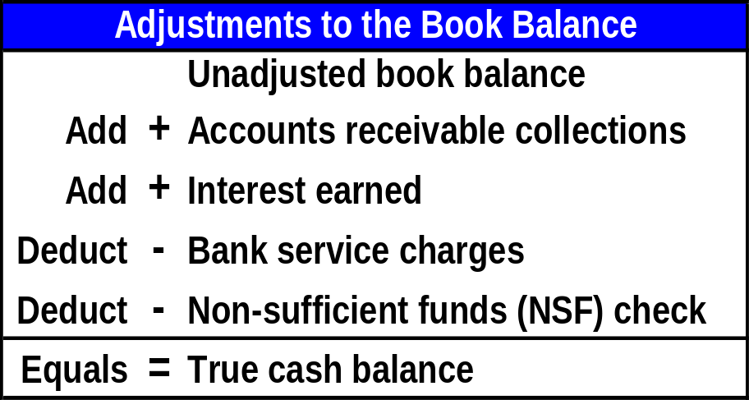
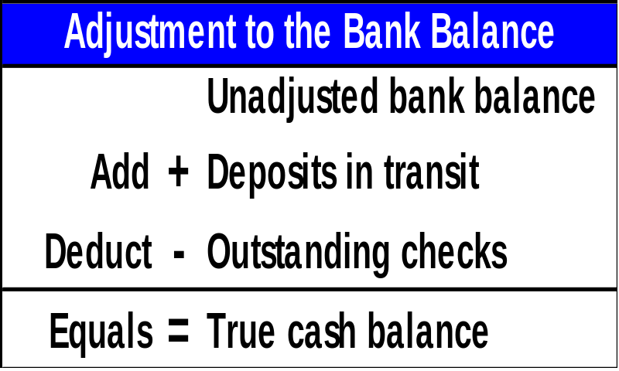
Reconciling the Bank Account
The bank reconciliation reports on the differences between the balance on the bank statement and the balance in the general ledger cash account. The reconciliation results in the true cash balance that will appear on the balance sheet.

Slide 23
Problems
I do: P5-4
You do: P5-3
Adaptive Practice – Chapter 6 Due 3/4
Homework – Chapter 5 Due 3/4
EXIT TICKETS DUE AT END OF EACH CLASS

